Slide 1
CLIP-Seg: Open-Text Semantics Segmentation for Robotics Manipulation
Lirui Wang, Boyuan Chen
6.843 Fa21

Slide 2
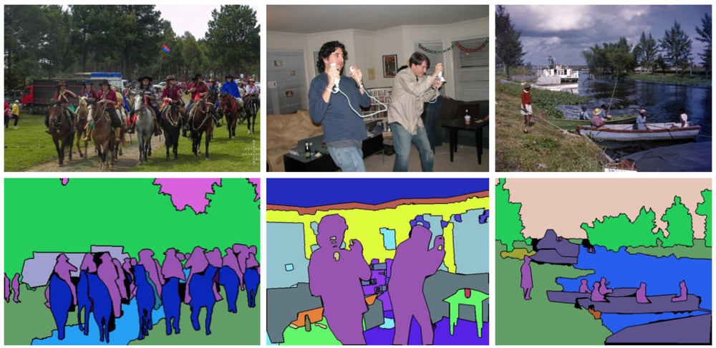
Semantic Segmentation
Class-Based Segmentation Open Text Segmentation
A small, finite set of object classes
Cannot query a particular instance
Cannot query with fine-grained attributes (color, position)
An infinite set of object “classes”
Can query with fine-grained attributes
Can generalize to multiple descriptions of same object (a white bottle, a bottle of shampoo)

Slide 3
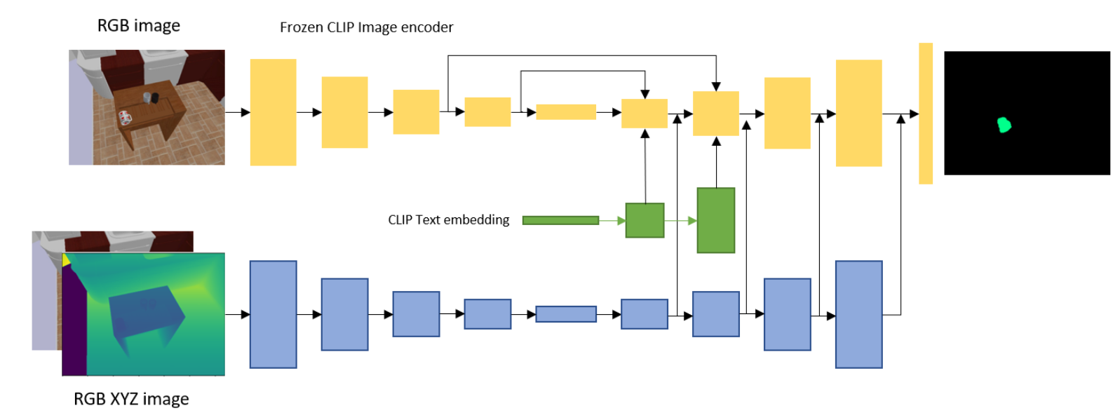
Method
Fuse CLIP embeddings with semantic information with two-stream U-net
Train on simulation / real world dataset with depth with object descriptions
Cliport: What and where pathways for robotic manipulation, Shridhar et al. 2021

Slide 4
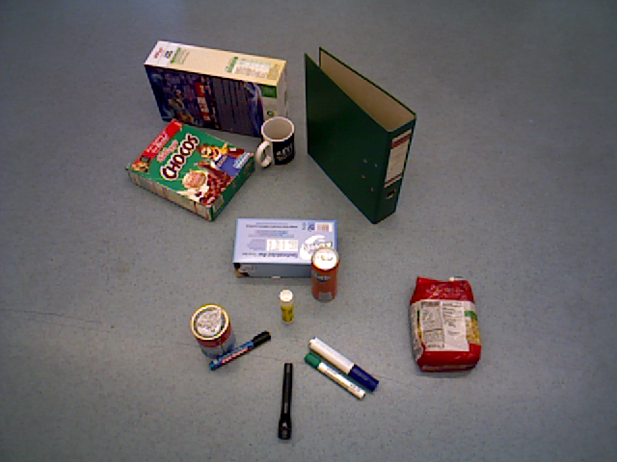
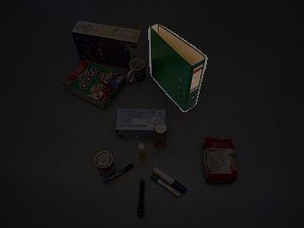
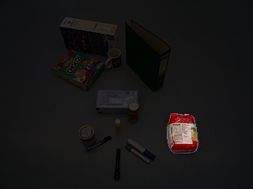
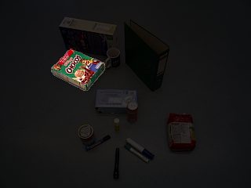
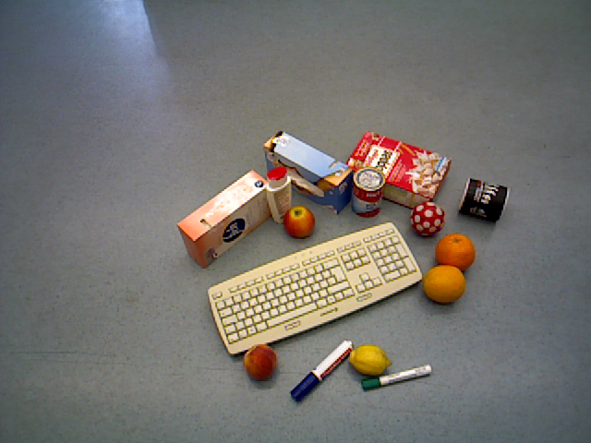
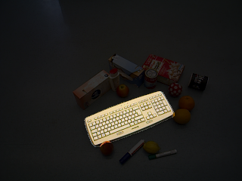
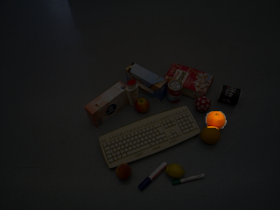
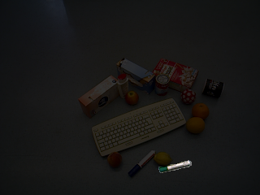
Resulted segmentation
A binder
A bag of pasta
A green box
A keyboard
An orange
A green marker

Slide 5
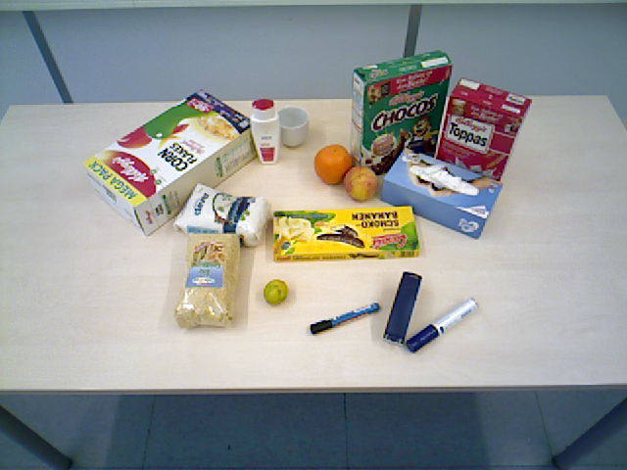
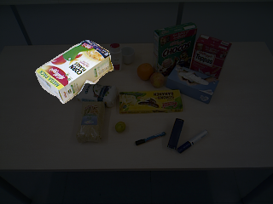
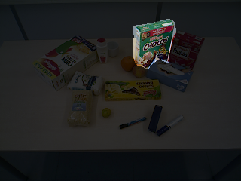
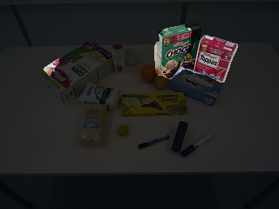
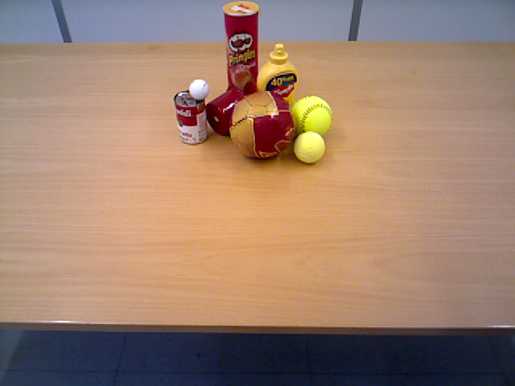
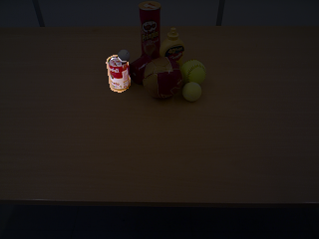
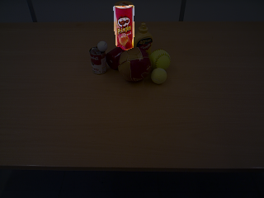
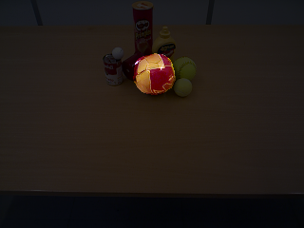
Instance query with spatial/attribute descriptions
The box on the left
A green box
A red box
A can on the left
A can of chips
Red and gold ball

Slide 6
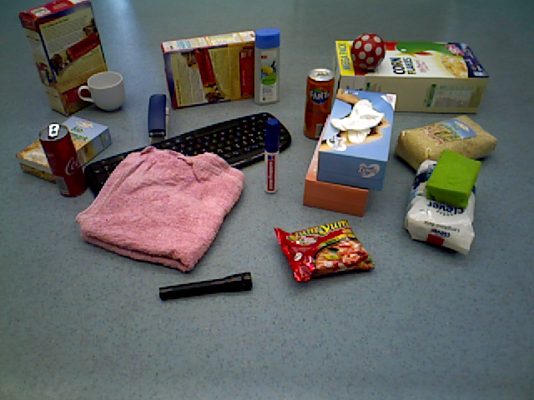
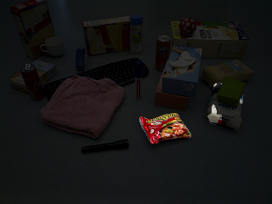
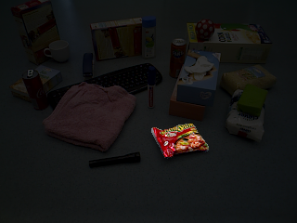
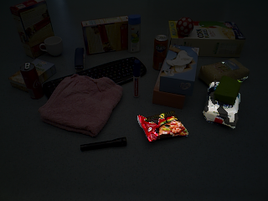
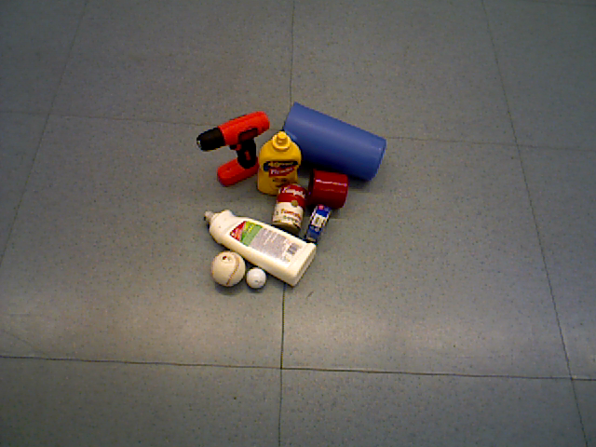
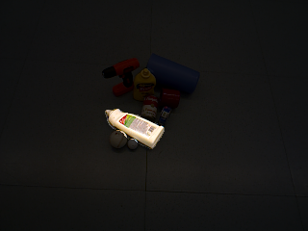

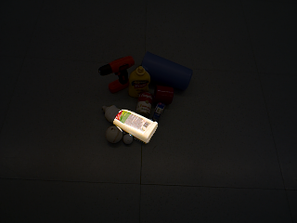
Generalized to unseen class names & descriptions
A bag of ramen
A red bag
A ramen bag
A white bottle
A bottle of shampoo
Shampoo

Slide 7
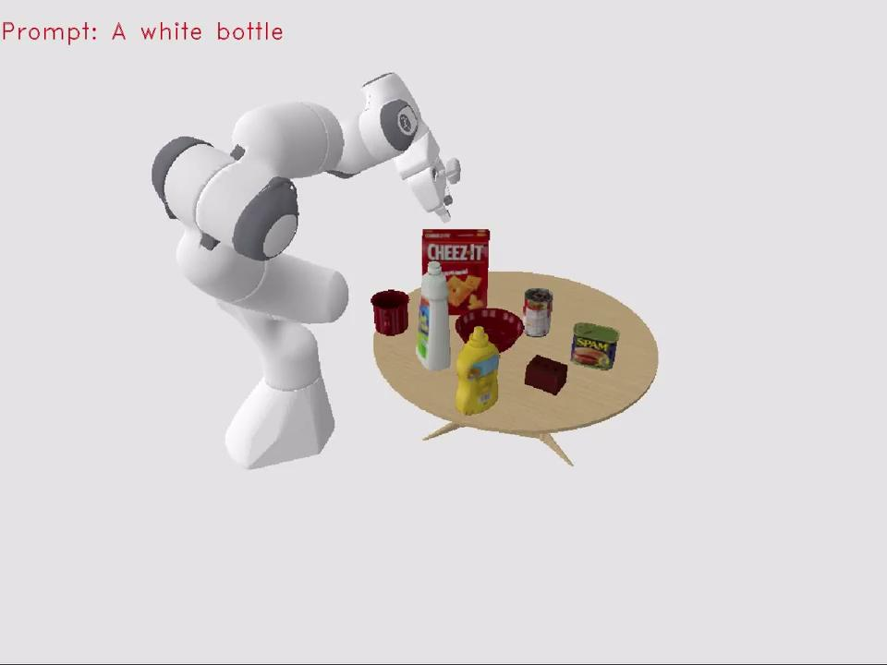
CLIP-Seg for manipulation
Maybe in 2051…
Hey Alexa Bot, give me my laptop!
Hierarchical Policies for Cluttered-Scene Grasping with Latent Plans, Wang et al. 2021

